Slide 1
CH 10: Graphs

Slide 2
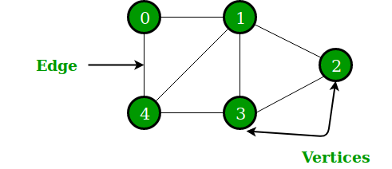
Introduction
Graphs are discrete structures consisting of vertices and edges that connect these vertices.
There are different kinds of graphs, depending on whether edges have directions, whether multiple edges can connect the same pair of vertices, and whether loops are allowed.

Slide 3
Content
CH 10
Graphs and Graph Models
Graph Terminology and Special Types of Graphs
Representing Graphs and Graph Isomorphism
Connectivity

Slide 4
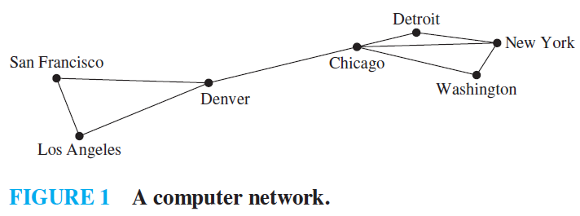

Graphs and Graph Models
DEFINITION 1: A graph $G = (V, E)$ consists of $V$, a nonempty set of vertices (or nodes) and $E$, a set of edges.
Each edge has either one or two vertices associated with it, called its endpoints. An edge is said to connect its endpoints.

Slide 5
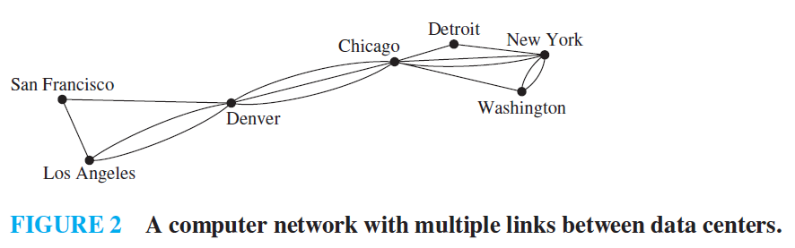
Graphs and Graph Models
Graphs that may have multiple edges connecting the same vertices are called multigraphs.

Slide 6
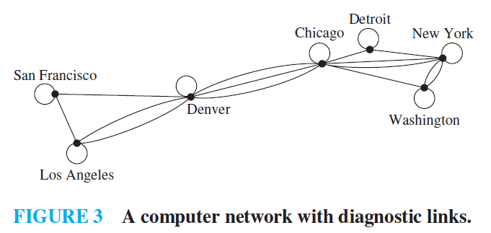
Graphs and Graph Models
Graphs that may include loops, and possibly multiple edges connecting the same pair of vertices or a vertex to itself, are sometimes called pseudographs.

Slide 7
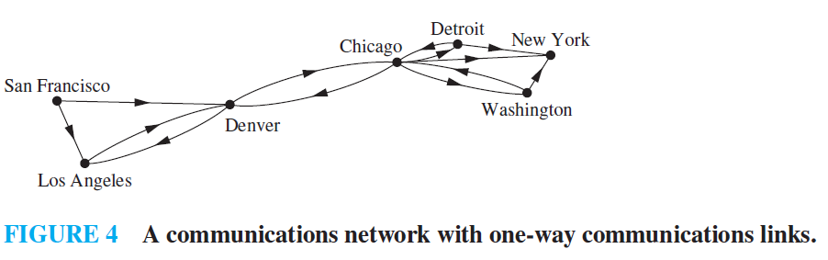

Graphs and Graph Models
DEFINITION 2: A directed graph (or digraph) $(V, E)$ consists of a nonempty set of vertices $V$ and a set of directed edges (or arcs) $E$.
The directed edge associated with the ordered pair $(u, v)$ is said to start at $u$ and end at $v$.

Slide 8
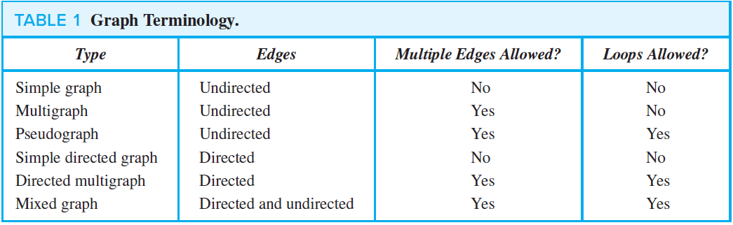
Graphs and Graph Models

Slide 9
Graphs and Graph Models
What are real applications of graphs?

Slide 10
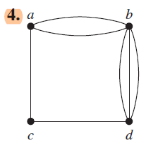
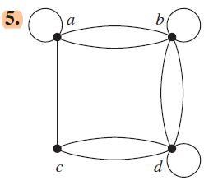
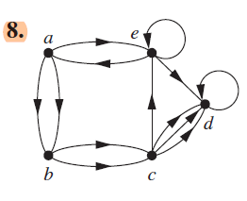
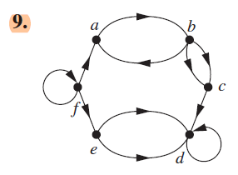
Exercises
Determine whether the graph shown has directed or undirected edges, whether it has multiple edges, and whether it has one or more loops. Use your answers to determine the type of graph in Table 1 this graph is.

Slide 11
Exercises
Determine whether the graph shown has directed or undirected edges, whether it has multiple edges, and whether it has one or more loops. Use your answers to determine the type of graph in Table 1 this graph is.
Graph | 4 | 5 | 8 | 9
Directed/not directed | Not directed | Not directed | Directed | Directed
Has multiple edge | Yes | Yes | Yes | Yes
Has loops | No | Yes | Yes | Yes
Type | multigraph | Pseudograph | Directed multigraph | Directed multigraph

Slide 12

Exercises
13. The intersection graph of a collection of sets $A_{1}, A_{2},…, A_{n}$ is the graph that has a vertex for each of these sets and has an edge connecting the vertices representing two sets if these sets have a nonempty intersection. Construct the intersection graph of these collections of sets. a) $A_{1}=\{0, 2, 4, 6, 8\}$, $A_{2}=\{0, 1, 2, 3, 4\}$, $A_{3}=\{1, 3, 5, 7, 9\}$, $A4=\{5, 6, 7, 8, 9\}$, $A_{5} = \left\{0, 1, 8, 9\right\}$
b) $A_{1}=\{…,−4,−3,−2,−1, 0\}$, $A_{2}=\{…,−2,−1, 0, 1, 2,…\}$,
$A_{3}=\{…,−6,−4,−2, 0, 2, 4, 6,…\}$, $A_{4}=\left\{…,−5,−3,−1, 1, 3, 5,…\right\}$ $A_{5}=\{…,−6,−3, 0, 3, 6,…\}$

Slide 13
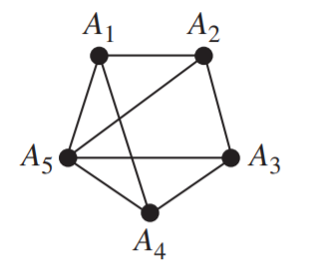

Exercises
a) $A_{1}=\{0, 2, 4, 6, 8\}$, $A_{2}=\{0, 1, 2, 3, 4\}$, $A_{3}=\{1, 3, 5, 7, 9\}$, $A4=\{5, 6, 7, 8, 9\}$, $A_{5} = \left\{0, 1, 8, 9\right\}$

Slide 14
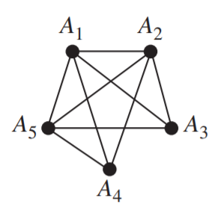

Exercises
b) $A_{1}=\{…,−4,−3,−2,−1, 0\}$, $A_{2}=\{…,−2,−1, 0, 1, 2,…\}$,
$A_{3}=\{…,−6,−4,−2, 0, 2, 4, 6,…\}$, $A_{4}=\left\{…,−5,−3,−1, 1, 3, 5,…\right\}$ $A_{5}=\{…,−6,−3, 0, 3, 6,…\}$

Slide 15
Exercises
35. Construct a precedence graph for the following program: S1: x := 0
S2: x := x + 1
S3: y := 2
S4: z := y
S5: x := x + 2
S6: y := x + z
S7: z := 4

Slide 16
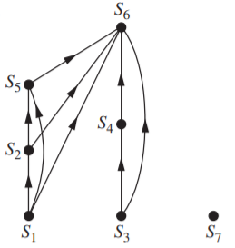
Exercises
35. Construct a precedence graph for the following program: S1: x := 0
S2: x := x + 1
S3: y := 2
S4: z := y
S5: x := x + 2
S6: y := x + z
S7: z := 4

Slide 17
TASK
Section 1
3, 6, 7
13 (c)

Slide 18
Content
CH 10
Graphs and Graph Models
Graph Terminology and Special Types of Graphs
Representing Graphs and Graph Isomorphism
Connectivity

Slide 19

Graph Terminology and Special Types of Graphs
DEFINITION 1: Two vertices $u$ and $v$ in an undirected graph $G$ are called adjacent (or neighbors) in $G$ if $u$ and $v$ are endpoints of an edge $e$ of $G$.
Such an edge $e$ is called incident with the vertices $u$ and $v$ and $e$ is said to connect $u$ and $v$.

Slide 20

Graph Terminology and Special Types of Graphs
DEFINITION 2: The set of all neighbors of a vertex $v$ of $G = (V, E)$, denoted by $N(v)$, is called the neighborhood of $v$.

Slide 21

Graph Terminology and Special Types of Graphs
DEFINITION 3: The degree of a vertex in an undirected graph is the number of edges incident with it, except that a loop at a vertex contributes twice to the degree of that vertex.
The degree of the vertex $v$ is denoted by $deg⁡(v)$.

Slide 22
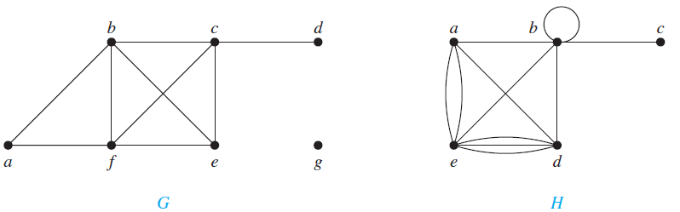
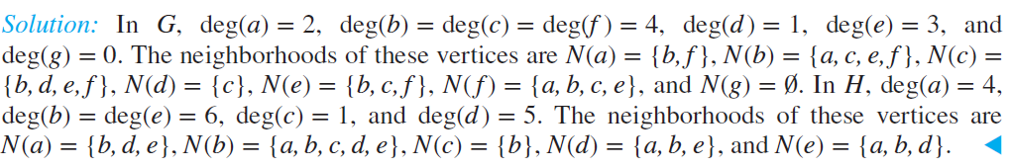
Graph Terminology and Special Types of Graphs
EXAMPLE 1: What are the degrees and what are the neighborhoods of the vertices in the graphs G and H displayed in Figure 1?

Slide 23
Graph Terminology and Special Types of Graphs
A vertex of degree zero is called isolated.
An isolated vertex is not adjacent to any vertex.
A vertex is pendant if and only if it has degree one.
A pendant vertex is adjacent to exactly one other vertex.

Slide 24

Graph Terminology and Special Types of Graphs
THE HANDSHAKING THEOREM: Let $G = (V, E)$ be an undirected graph with $m$ edges. Then $2m=\sum_{v∈V}{\deg\left(v\right)}$.
EXAMPLE 3 How many edges are there in a graph with 10 vertices each of degree six?
Solution: Because the sum of the degrees of the vertices is 6 ⋅ 10 = 60, it follows that 2m = 60 where m is the number of edges. Therefore, m = 30.

Slide 25

Graph Terminology and Special Types of Graphs
Definition 4: When $(u, v)$ is an edge of the graph $G$ with directed edges, $u$ is said to be adjacent to $v$ and $v$ is said to be adjacent from $u$.
The vertex $u$ is called the initial vertex of $(u, v)$.
The vertex $v$ is called the terminal or end vertex of $(u, v)$.
The initial vertex and terminal vertex of a loop are the same.

Slide 26

Graph Terminology and Special Types of Graphs
Definition 5: In a graph with directed edges the in-degree of a vertex $v$, denoted by $\deg^{−}(v)$, is the number of edges with $v$ as their terminal vertex. The out-degree of $v$, denoted by $\deg^{+}(v)$, is the number of edges with $v$ as their initial vertex.
Note that a loop at a vertex contributes 1 to both the in-degree and the out-degree of this vertex.

Slide 27
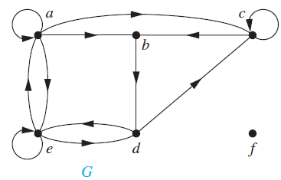

Graph Terminology and Special Types of Graphs
EXAMPLE 4: Find the in-degree and out-degree of each vertex in the graph G.
Solution: The in-degrees in $G$ are $\deg^{−}\left(a\right)=2, \deg^{−}\left(b\right)=2, \deg^{−}\left(c\right)= 3, \deg^{−}\left(d\right)=2,\deg^{−}(e)=3,$and$\deg^{−}(f )=0$. The out-degrees are $\deg^{+}\left(a\right)=4, \deg^{+}(b)=1, \deg^{+}(c)=2, \deg^{+}(d)=2, \deg^{+}(e)=3,$and$\deg^{+}( f )=0$.

Slide 28

Graph Terminology and Special Types of Graphs
THEOREM 3: Let G = (V, E) be a graph with directed edges. Then $\sum_{v∈V}{\deg^{−}\left(v\right)=\sum_{v∈V}{\deg^{+}\left(v\right)=|E| }}$
The sum of the in-degrees and the sum of the out-degrees of all vertices in a graph with directed edges are the same.
Both sums are the number of edges in the graph.

Slide 29
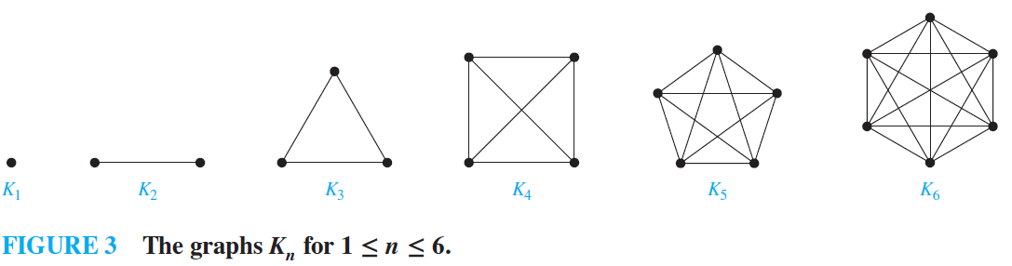

Graph Terminology and Special Types of Graphs
Special graphs: Complete Graphs: A complete graph on $n$ vertices, denoted by $K_{n}$, is a simple graph that contains exactly one edge between each pair of distinct vertices.

Slide 30
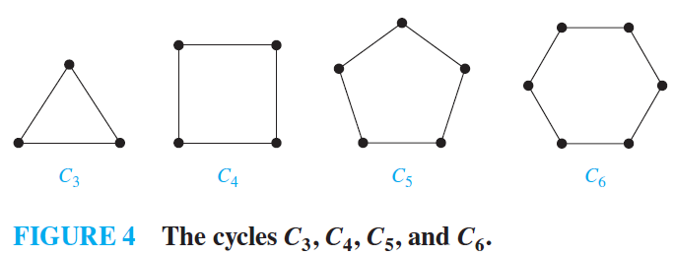

Graph Terminology and Special Types of Graphs
Special graphs: Cycles: A cycle $C_{n}$, $n≥3$, consists of $n$ vertices $v_{1}, v_{2},…, v_{n}$ and edges $\{v_{1}, v_{2}\}, \{v_{2}, v_{3}\},…, \{v_{n−1}, v_{n}\},$and$\{v_{n}, v_{1}\}$.

Slide 31
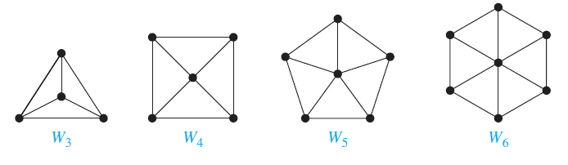

Graph Terminology and Special Types of Graphs
Special graphs: Wheels: We obtain a wheel $W_{n}$ when we add an additional vertex to a cycle $C_{n}$, for n ≥ 3, and connect this new vertex to each of the $n$ vertices in $C_{n}$, by new edges.

Slide 32
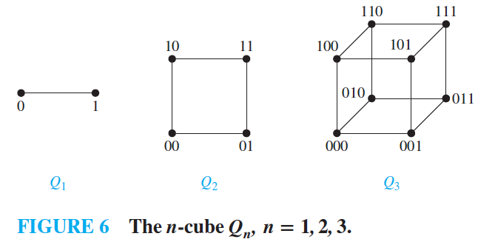

Graph Terminology and Special Types of Graphs
Special graphs: n-Cubes: An n-dimensional hypercube, denoted by $Qn$, is a graph that has vertices representing the $2^{n}$ bit strings of length $n$. Two vertices are adjacent if and only if the bit strings that they represent differ in exactly one bit position.

Slide 33

Graph Terminology and Special Types of Graphs
DEFINITION 6: A simple graph $G$ is called bipartite if its vertex set $V$ can be partitioned into two disjoint sets $V_{1}$ and $V_{2}$ such that every edge in the graph connects a vertex in $V_{1}$ and a vertex in $V_{2}$.
No edge in $G$ connects either two vertices in $V_{1}$ or two vertices in $V_{2}$.
Example: marriage between men and women

Slide 34
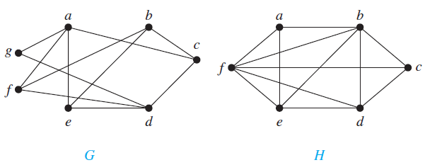
Graph Terminology and Special Types of Graphs
EXAMPLE 11: Are the graphs G and H displayed in Figure 8 bipartite?
Solution: Graph G is bipartite because its vertex set is the union of two disjoint sets, {a, b, d} and {c, e, f, g}. Graph H is not bipartite because its vertex set cannot be partitioned into two subsets so that edges do not connect two vertices from the same subset.

Slide 35

Graph Terminology and Special Types of Graphs
DEFINITION 7: A subgraph of a graph $G = (V, E)$ is a graph $H = (W, F)$, where $W ⊆ V$ and $F ⊆ E$.
DEFINITION 9: The union of two simple graphs $G_{1}=(V_{1}, E_{1})$ and $G_{2}=(V_{2}, E_{2})$ is the simple graph with vertex set $V_{1}∪V_{2}$ and edge set $E_{1}∪E_{2}$.

Slide 36
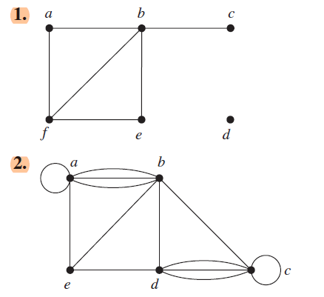
Exercises
In Exercises 1–3 find the number of vertices, the number of edges, and the degree of each vertex in the given undirected graph. Identify all isolated and pendant vertices.

Slide 37
Exercises
In Exercises 1–3 find the number of vertices, the number of edges, and the degree of each vertex in the given undirected graph. Identify all isolated and pendant vertices.
v = 6; e = 6; deg(a) = 2, deg(b) = 4, deg(c) = 1,
deg(d) = 0, deg(e) = 2, deg(f) = 3; c is pendant; d is isolated.
v = 5; e = 13; deg(a) = 6, deg(b) = 6, deg(c) = 6,
deg(d) = 5, deg(e) = 3; There are no pendant or isolated vertices

Slide 38
Exercises
4. Find the sum of the degrees of the vertices of each graph in Exercises 1–3 and verify that it equals twice the number of edges in the graph.

Slide 39
Exercises
4. Find the sum of the degrees of the vertices of each graph in Exercises 1–3 and verify that it equals twice the number of edges in the graph.
the sum is 2+4+1+0+2+3 = 12 = 2 * 6; there are 6 edges.
the sum is 6+6+6+5+3 = 26 = 2*13; there are 13 edges.

Slide 40
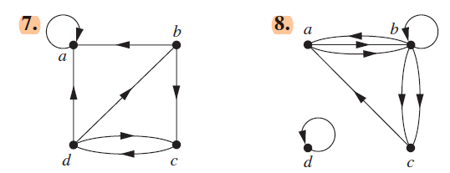
Exercises
In Exercises 7–9 determine the number of vertices and edges and find the in-degree and out-degree of each vertex for the given directed multigraph.

Slide 41


Exercises
In Exercises 7–9 determine the number of vertices and edges and find the in-degree and out-degree of each vertex for the given directed multigraph.
v = 4; e = 7; $\deg^{−}\left(a\right)=3, \deg^{−}\left(b\right)=1, \deg^{−}(c)=2, \deg^{−}(d)=1, \deg^{+}(a) = 1, \deg^{+}(b)=2, \deg^{+}(c)=1, \deg^{+}(d)=3$
v = 4; e = 8; $\deg^{−}\left(a\right)=2, \deg^{−}\left(b\right)=3, \deg^{−}(c)=2, \deg^{−}(d)=1, \deg^{+}(a) =2, \deg^{+}(b)=4, \deg^{+}(c)=1, \deg^{+}(d)=1$

Slide 42
Exercises
10. For each of the graphs in Exercises 7–9 determine the sum of the in-degrees of the vertices and the sum of the out-degrees of the vertices directly. Show that they are both equal to the number of edges in the graph.

Slide 43
Exercises
10. For each of the graphs in Exercises 7–9 determine the sum of the in-degrees of the vertices and the sum of the out-degrees of the vertices directly. Show that they are both equal to the number of edges in the graph.
The sum of the in-degrees is 3+1+2+1 = 7, and the sum of the out-degrees is 1+2+1+3 = 7;
there are 7 edges.
The sum of the in-degrees is 2+3+2+1 = 8, and the sum of the out-degrees is 2 + 4 + 1 + 1 = 8; there are 8 edges.

Slide 44
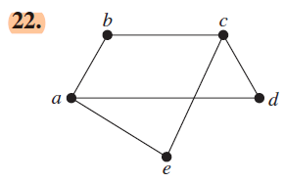
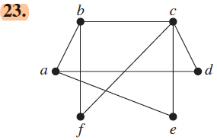
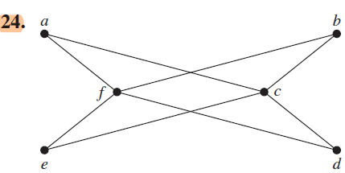
Exercises
In Exercises 21–25 determine whether the graph is bipartite.

Slide 45


Exercises
In Exercises 21–25 determine whether the graph is bipartite.
This graph is bipartite, with bipartition $\{a, c\}$ and $\{b, d,\text{e}\}$
This is the complete bipartite graph, with bipartition $\{f, c\}$ and $\{a, b, d,\text{e}\}$
Not bipartite

Slide 46
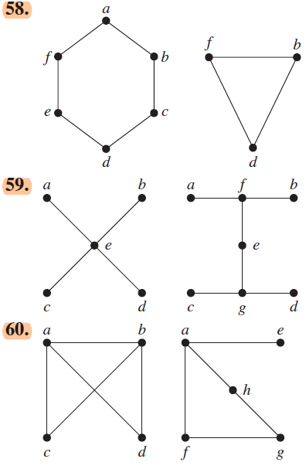
Exercises
In Exercises 58–60 find the union of the given pair of simple graphs. (Assume edges with the same endpoints are the same.)

Slide 47
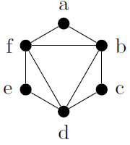
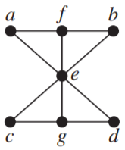
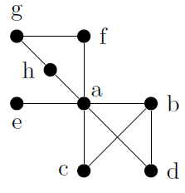
Exercises
In Exercises 58–60 find the union of the given pair of simple graphs. (Assume edges with the same endpoints are the same.)

Slide 48
TASK
Section 10.2
3
9 and 10 (9)
21
25

